Slide 1
Team Eagle wingsuit: CAD modifications, 3D model, and future plans
Luke Peterson
Embry-riddle aeronautical university

Slide 2
What is team eagle wingsuit
Team Advisor: Professor Timothy Sestak
Background
His vision

Slide 3
objectives
Status of current designs
How can they be improved?
What have I done?
9 new designs
Rapid-prototyping
Water tunnel preparations

Slide 4
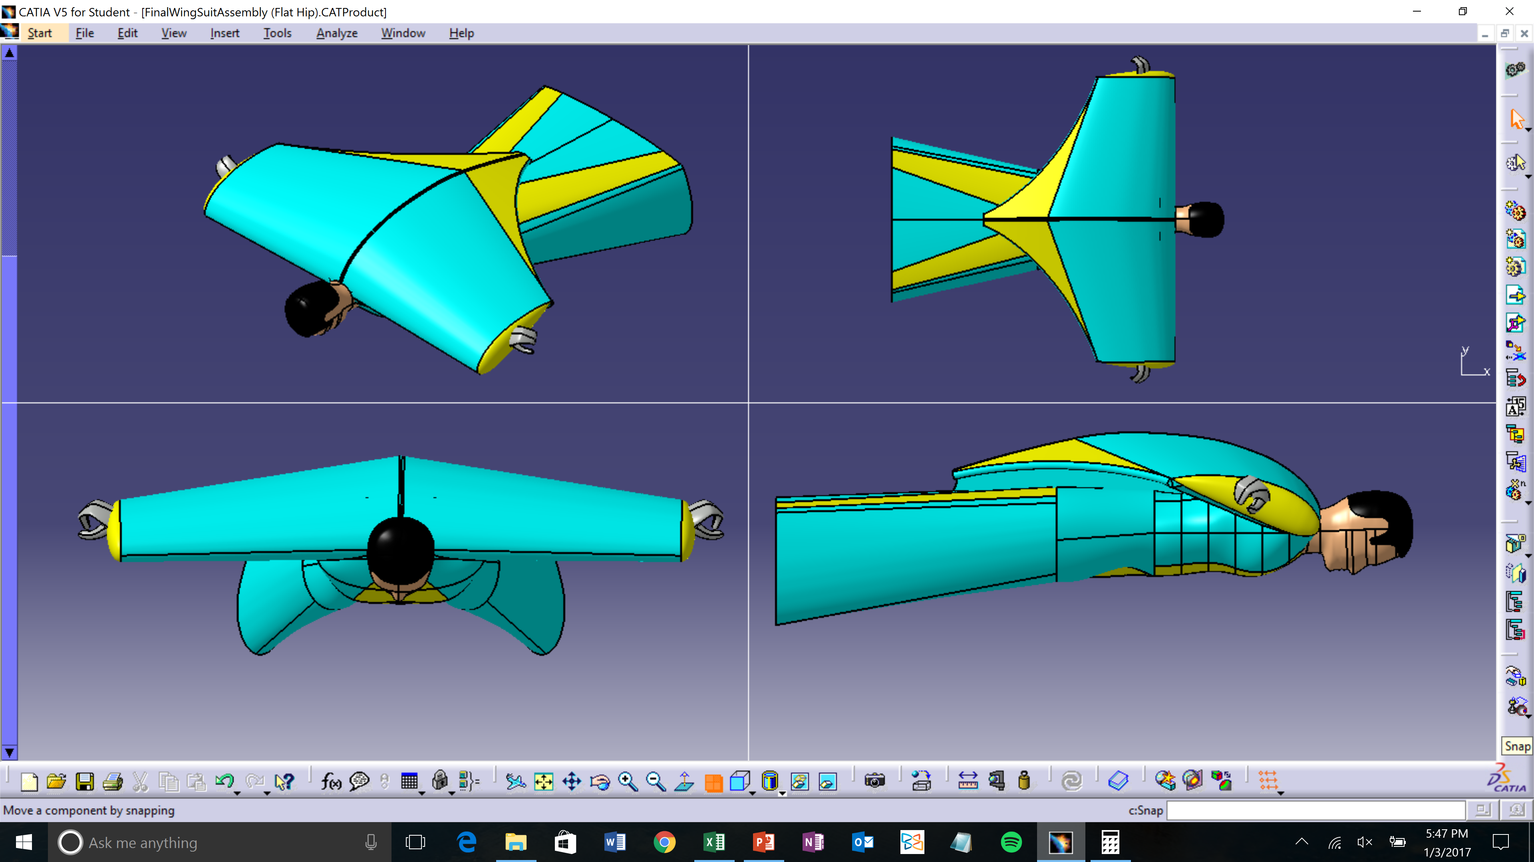
Previous design

Slide 5
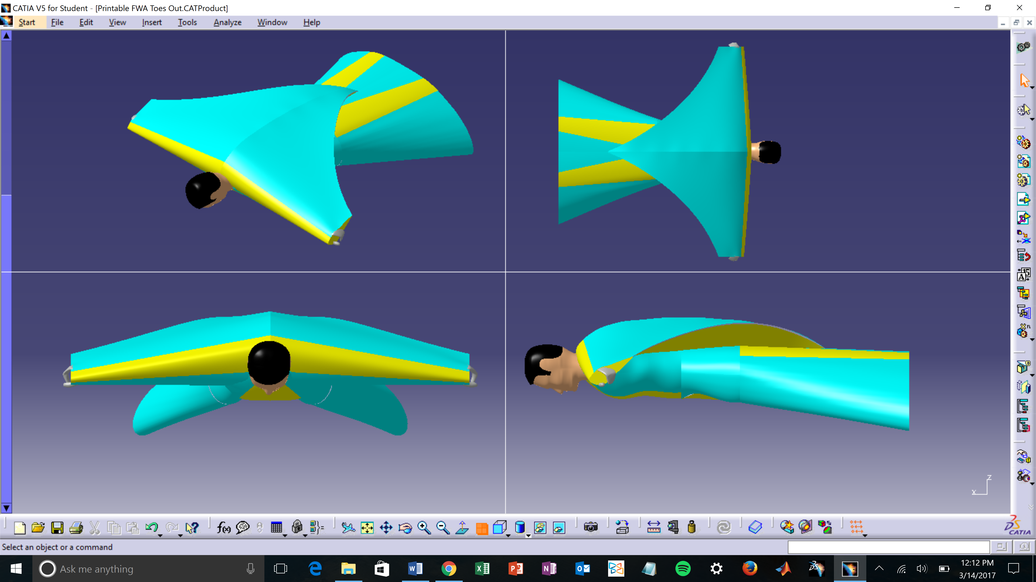
Current design

Slide 6
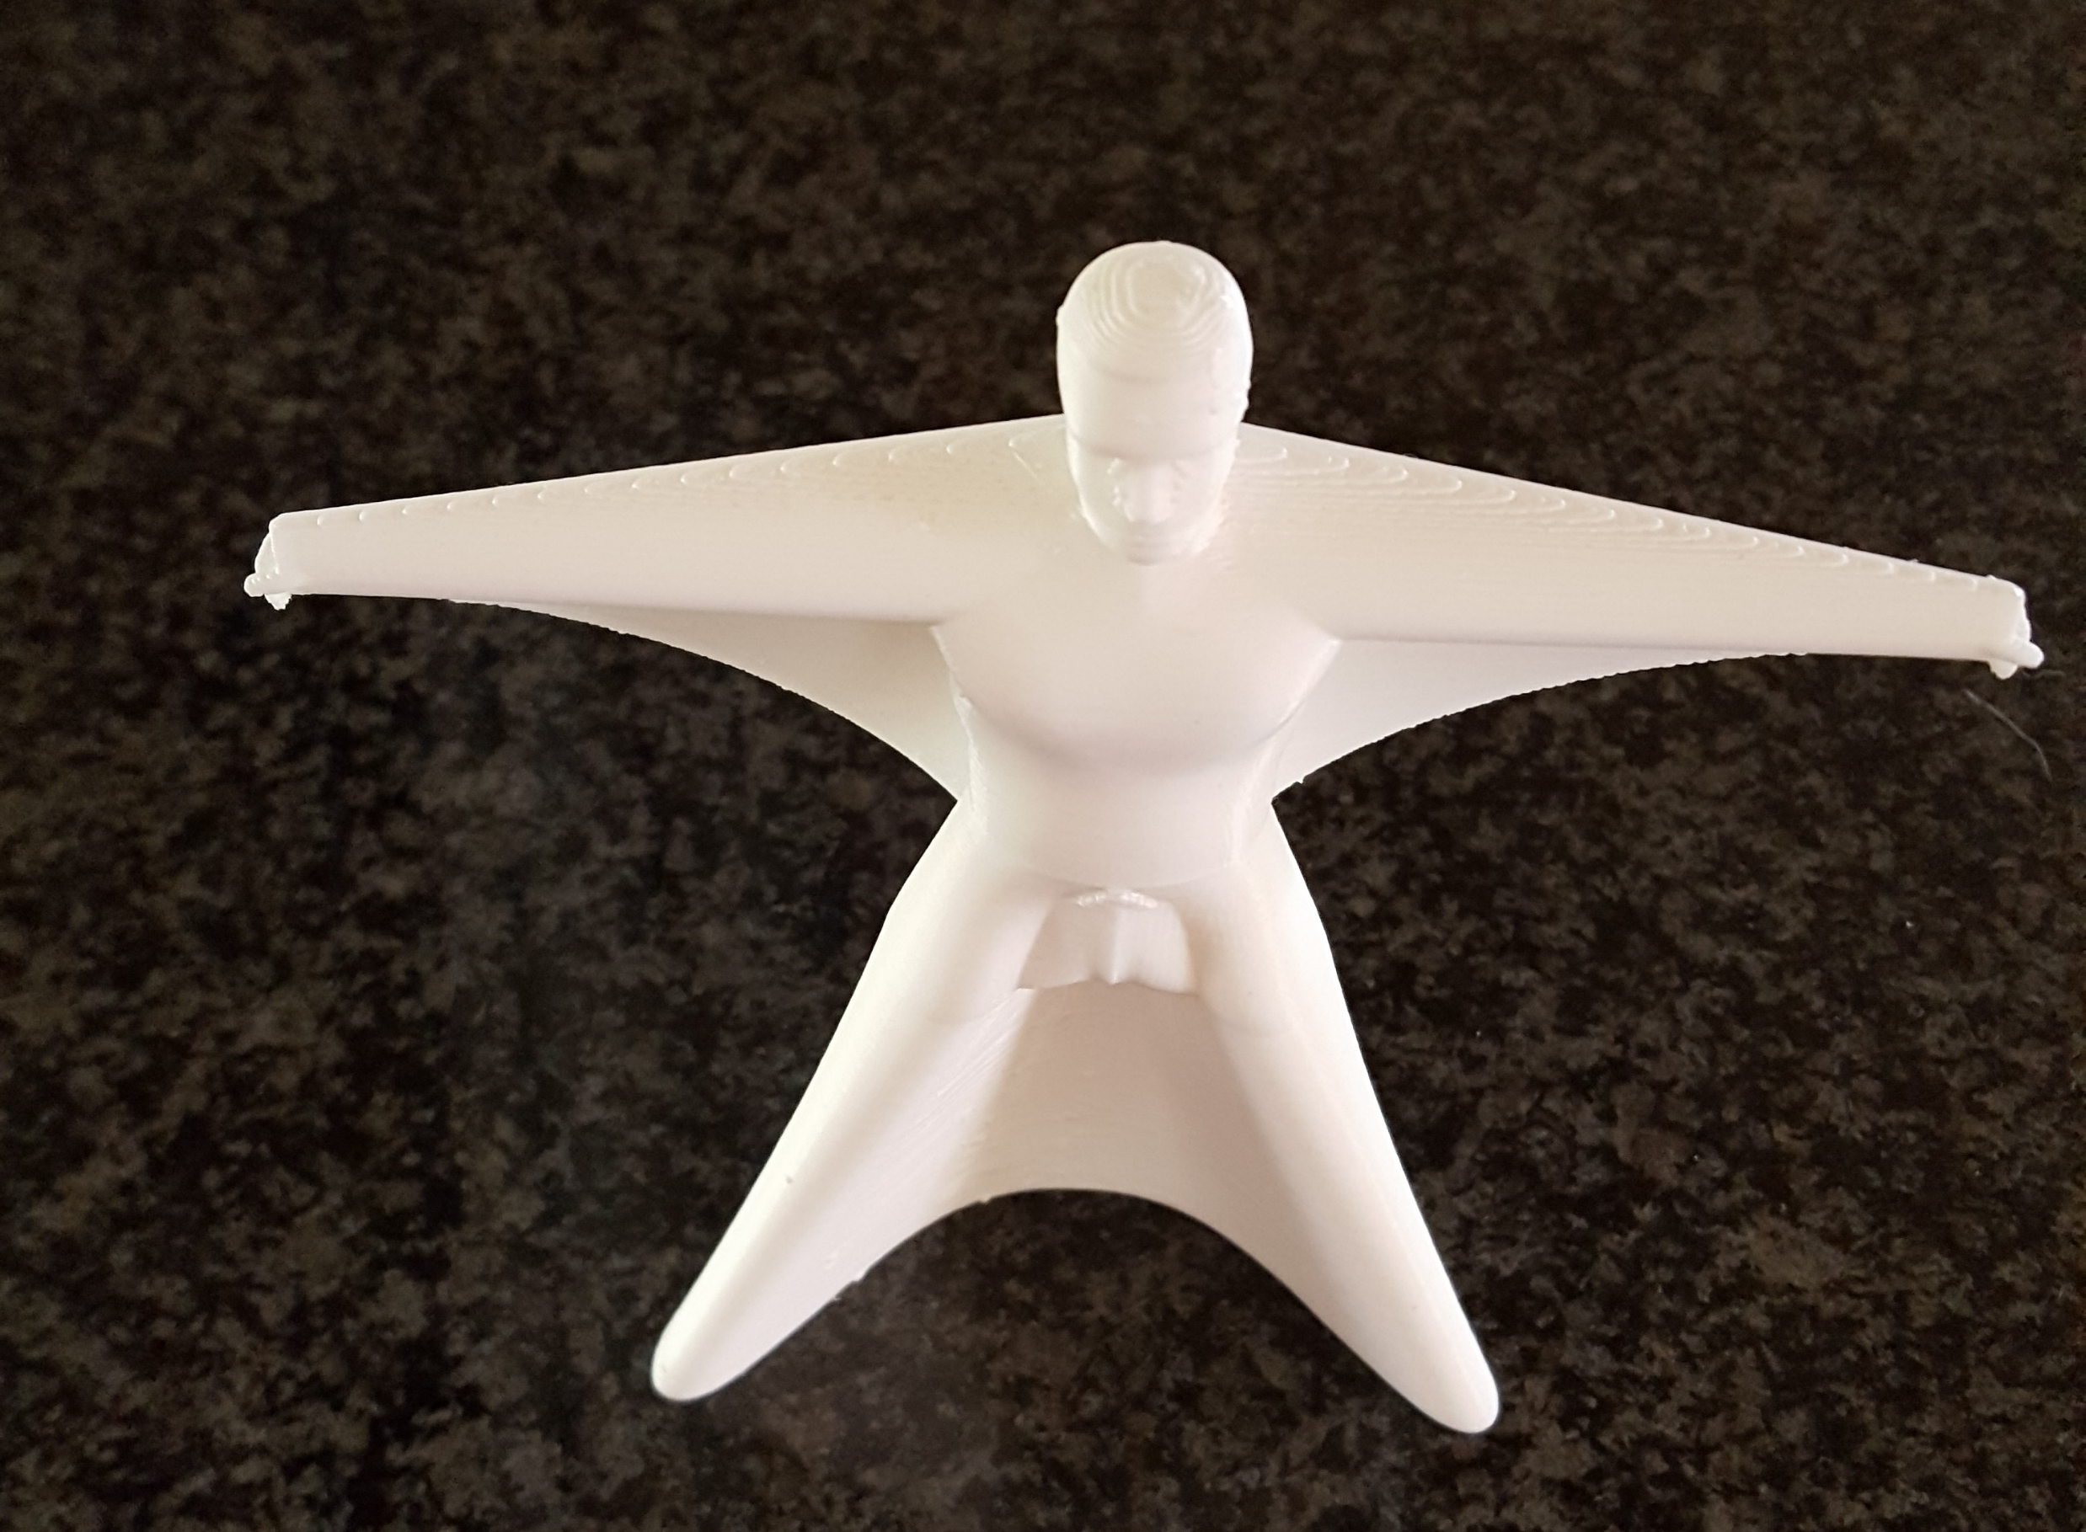
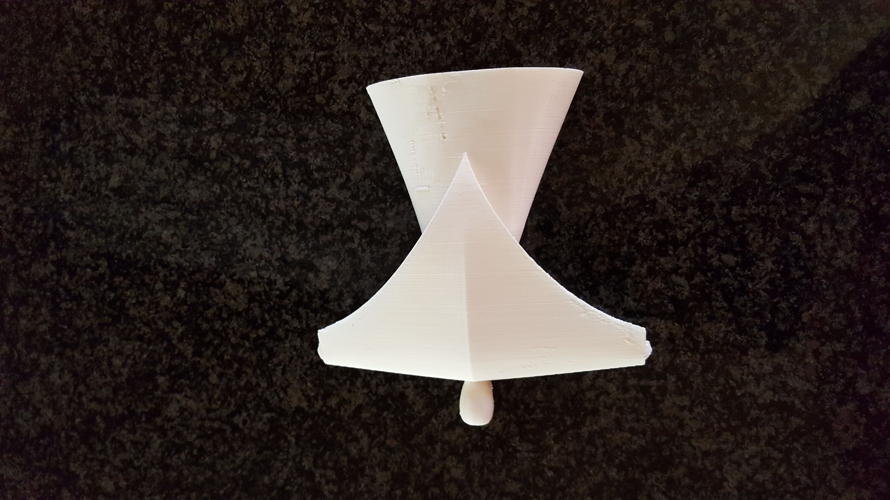
Rapid prototype

Slide 7
Future endeavors
Water tunnel testing
CFD visualizations
Variable angle of attack mechanism
Flight control analysis
Fabric model

Slide 8


Questions?

